Slide 1
Patterns - part 1
Miss L
Year 7

Slide 2
Learning Intentions
Students will be able to
Complete a number pattern
Complete a spatial pattern

Slide 3

Think - Pair - Share
Think:
  Write down what you think a pattern is.
  Write or draw an example of a pattern
Pair:
  Share with the person next to you, your pattern.
  Write down your partners pattern in your book
Share:
  Your teacher will call on some of you to:
    Share your definition of a pattern
    To come and draw your pattern on the board
WICOR

Slide 4
24
7
30
Linear Equations
Date:
EQ – What is a pattern and how does it work?
When a sequence of numbers or shapes follows the same rule
This means they increase or decrease by the same amount each time
Who knows this famous pattern:
0, 1, 1, 2, 3, 5, 8, 13, 21, 34, ...
It’s the Fibonacci Sequence.
What is the next number in the sequence?
What is a pattern?

Slide 5


Slide 6
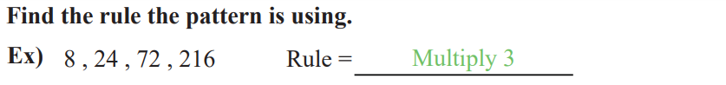
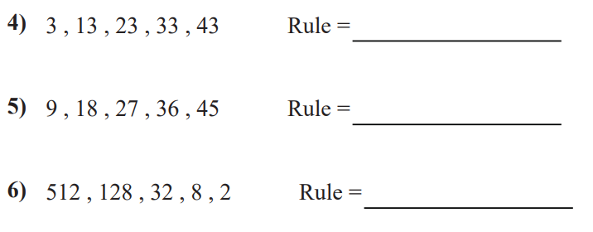

Slide 7
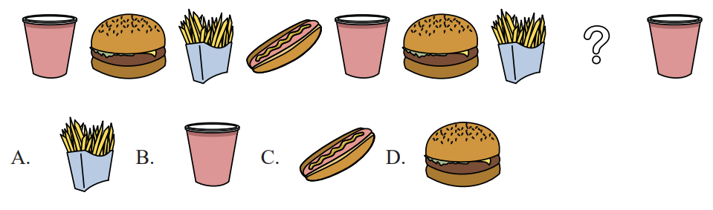
What picture should fill the gap?

Slide 8
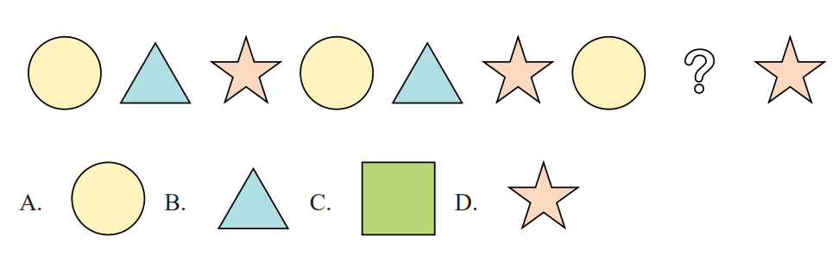
What picture should fill the gap?

Slide 9
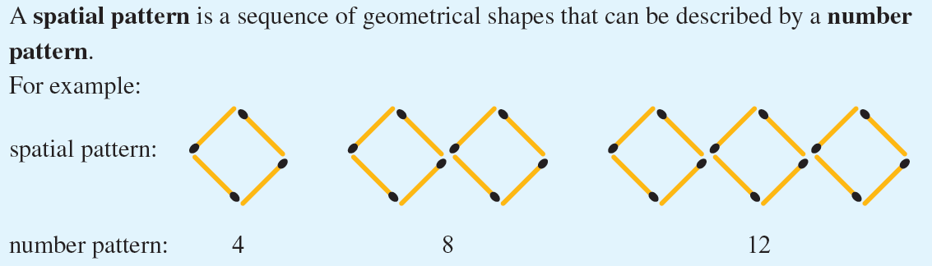
24
7
30
Linear Equations
Date:
EQ – What is a pattern and how does it work?
What is a spatial pattern?

Slide 10
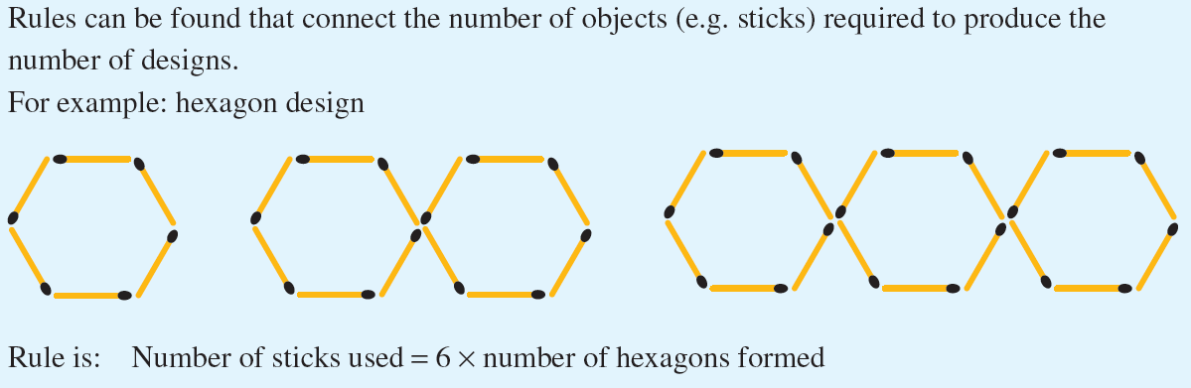
24
7
30
Linear Equations
Date:
EQ – What is a pattern and how does it work?
What is a spatial pattern?
Can you come up with the rule for this pattern?

Slide 12
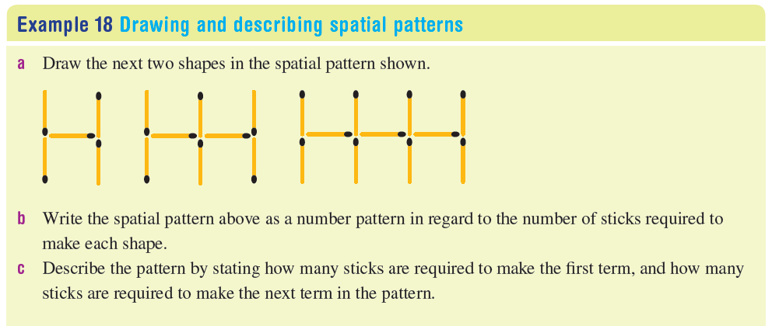
Practice

Slide 13
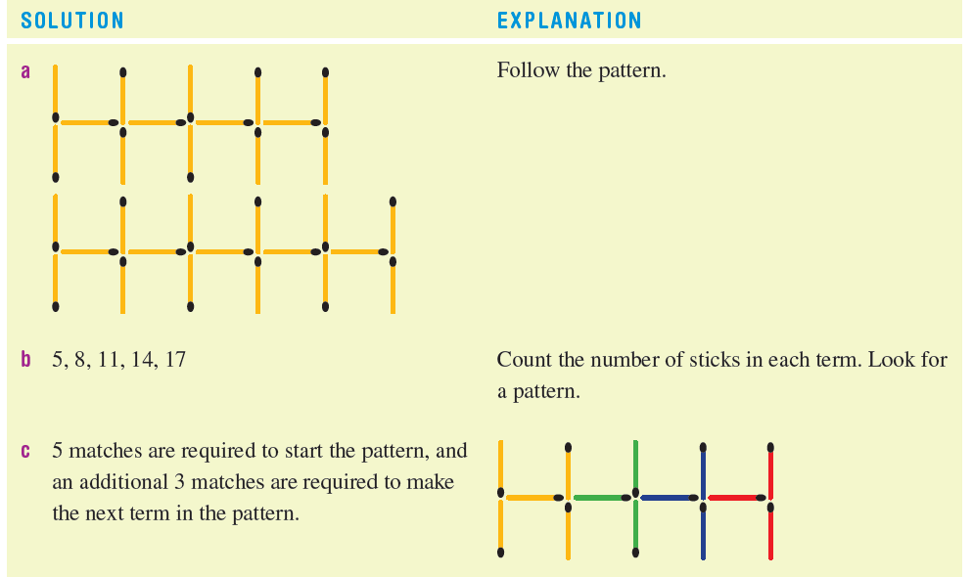
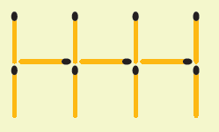
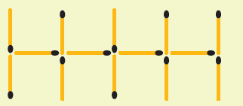

Slide 14
Transition
When
  When your teachers says you may go…..
What
  You will come and get a set of match sticks for you and your partner and 2 worksheets
Who
  Number 2 person
  GO
Notes:
Give kids numbers 1 and 2 before you start. Make it clear that no match stick must not be broken

Slide 15
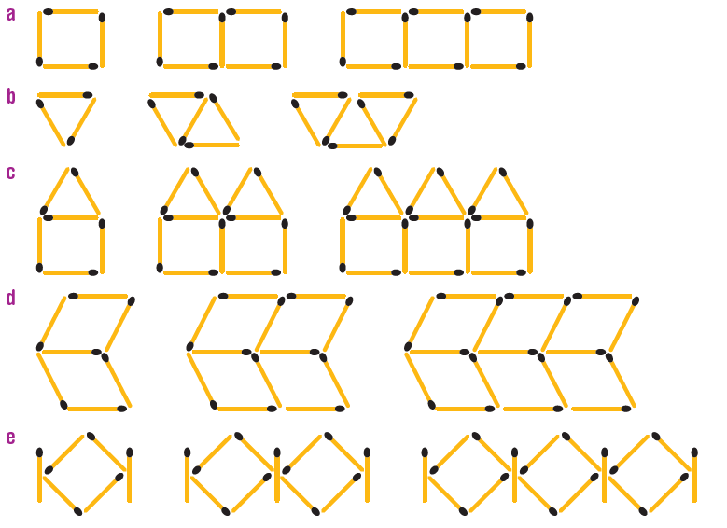
Task
For each of the following spatial patterns:
  Make the next two shapes in the pattern
  Write the spatial pattern as a number pattern
  Describe the pattern by stating how many sticks are required to make the first term and how many more sticks are required to make the next term in the pattern.

